Slide 1
S.R.S Sr. Sec School Rohtak
Name – Prince
Class – 12 Science
Roll No - 1207

Slide 2
Introduction
World No Tobacco Day (WNTD) is observed every year on 31 May
The main motive of this act is to motivate people to prevent the use of tobacco for one day .
Later in 1988 the organisation change the date to 31 May.

Slide 3
World No Tobacco Day 2023 Theme
“We Need Food, No Tobacco”

Slide 4
Common reasons for smoking
People smoke… …as a way of coping with negative emotions of feelings.
…to lose weight or stay thin.
…to socialize with others.

Slide 5
Why Child Smoke
Young people start smoking because…
Their friends smoke.
They want to feel more “grown up.”
The tobacco industry makes it seem normal.

Slide 6
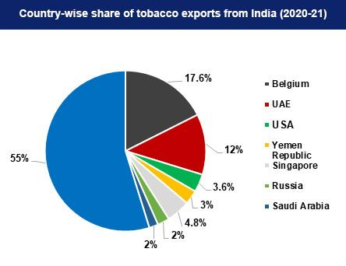

Slide 7
Steps to Say No To Tobacco
3 Stages to Quitting.....
Pre-contemplation (not thinking about quitting)
Contemplation (thinking about quitting but not ready to quit)
Preparation (getting ready to quit)

Slide 8
Thank You

