Slide 1
Welcome
TO
PPT FILE
ANKIT 12TH (ARTS)

Slide 2
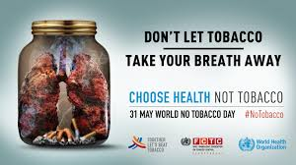

Slide 3
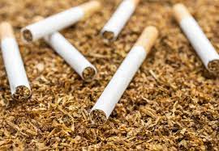
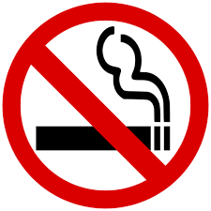
TOBACCO
Tobacco is a product prepared from the leaves of the tobacco plant by curing them. The plant is part of the genus Nicotiana and of the Solanaceae (nightshade) family.

Slide 7
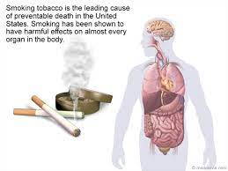

Slide 8
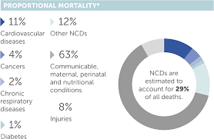
TOBACCO AND NON-COMMUNICABLE DISEASES
IN 2008, ALMOST TWO-THIRDS OF ALL DEATHS, OR
36 MILLION, WERE CAUSED BY NCDs; NEARLY 80% OF
THESE DEATHS OCCURRED IN LOW-AND MIDDLE-INCOME
COUNTRIES.
TOBACCO USE IS PROJECTED TO KILL 1 BILLION
PEOPLE IN THE 21ST CENTURY.

Slide 9
Tobacco is the leading preventable risk factor for NCDs
The major risk factors that cause NCDs
Include tobacco use, poor diet, physical
Inactivity, and harmful use of alcohol.
Tobacco use is the single most preventable
Cause of death
Globally, more than 1 billion people smoke

Slide 10
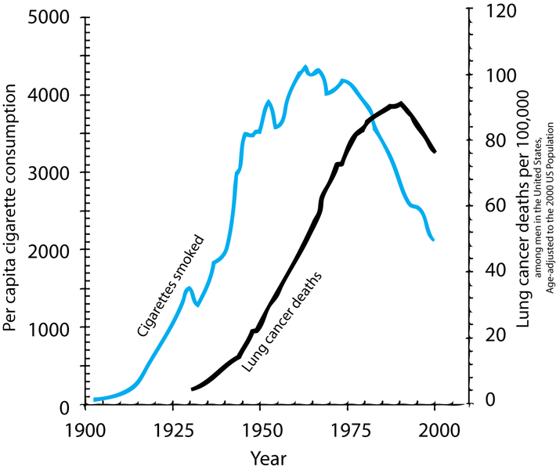
TOBACCO CAUSE OF CANCER
The primary risks of tobacco usage include
many forms of cancer, particularly lung cancer,
And head and neck and stomach cancer etc.
The risk of dying from lung cancer before
Age 85 is 22.1 % for a male smoker and 11.9%
For a female smoker, in the absence of
Competing causes of death.

Slide 11
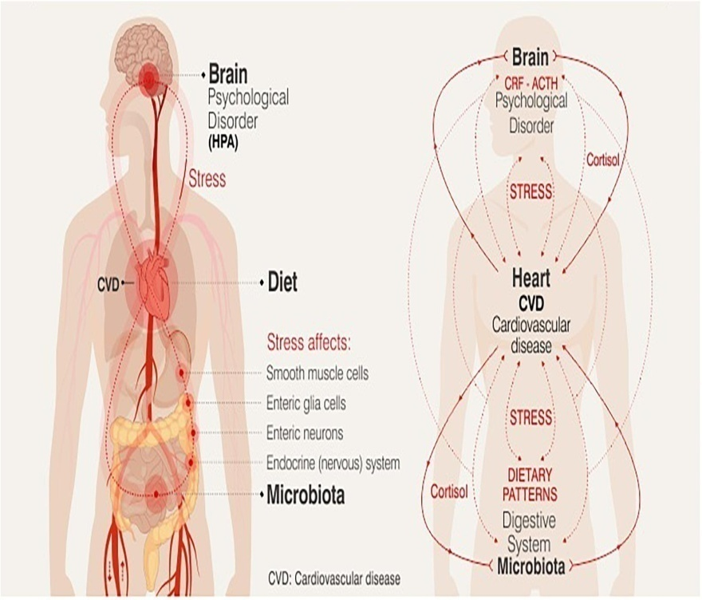
Cardiovascular Disease
Inhalation of tobacco smoke causes several
Immediate responses within the heart and
Blood vessels i.e. the heart rate begins to
rise , increasing by 30 percent during the
first 10 minutes of smoking.
Smoking also increases the chance of heart
Disease, stroke, atherosclerosis, and peripheral
Vascular disease.

Slide 12
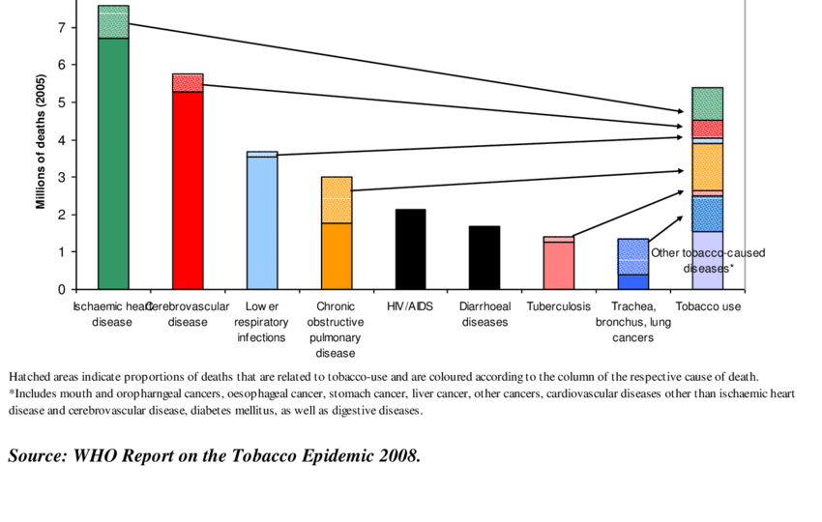
The Global Burden of tobacco
Is a development issue
Tobacco use hinders development and worsens
Poverty, yet tobacco use is increasing in many
low- and middle-income countries.
Addiction to tobacco causes poor families to
spend more on tobacco and less on food, health
Care and education.

Slide 13
Thank You

