Slide 1
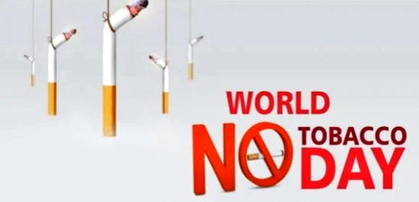
31st MAY 2021
Organised by :- S.R.S. Public School, Rohtak, Haryana, Part of NSS curriculum
Made by :– Atul Anand
12th , Science
^{(NSS Volunteer)}

Slide 2
Introduction
☆ In 1987, the World Health Organisation passeda resolution that announced April 7, 1988, as 'World No Smoking Day’.
☆ The act was passed to motivate people to prevent using tobacco for at least 24 hours.
☆ Later in 1988, the organisation passed another resolution that World No Tobacco Day will be observed on May 31.

Slide 3
Why do we people start Smoking ?
Most people who smoke started smoking when they were teenagers.
Those who have friends and/or parents who smoke are more likely to start smoking than those who don’t.
Some teenagers say that they "just wanted to try it," or they thought it was "cool" to smoke.
To avoid tension, anxiety, depressant.
Movies showing people smoking are another big influence.

Slide 4
World No Tobacco Day 2023 Theme
The theme of 2023 World No Tobacco Day is – {We need food, not tobacco}.The theme is picked to convey the message to the tobacco producers to move to alternative farming like food crops so as to control the food crisis.

Slide 5
Tobacco in india
☆☆ 43% of rural and 28% of urban Indian males aged 10 years and above consume tobacco and tobacco-containing products.
☆☆ 11% of rural and 5% of urban Indian females aged 10 years and above used tobacco and tobacco-containing products.
☆☆ According to the Indian Council for Medical Research (ICMR) there are 200 million active tobacco users in India.
☆☆ Tobacco kills 800,000 people and 12 million become ill every year in India due to its consumption.

Slide 6
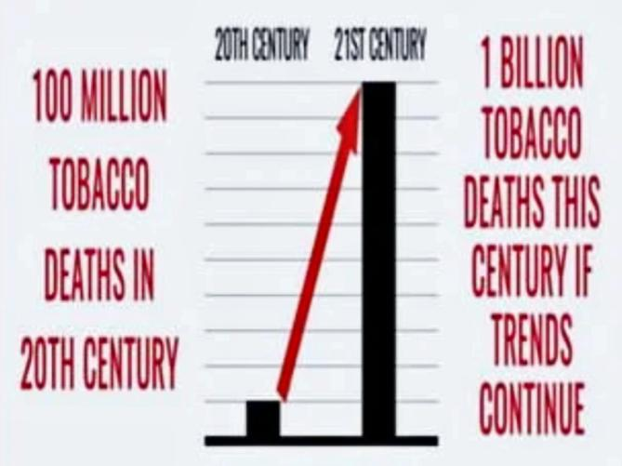
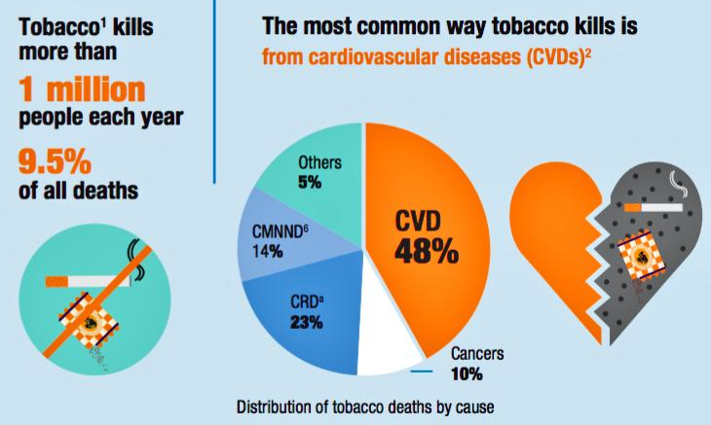
Statistics
⚫ The tobacco is one of the biggest public health threats the world has ever faced, killing more than 8 million people a year around the world.
⚫ According to WHO, tobacco kills more than 1 million people each year in India, accounting for 9.5% of all deaths.
⚫India is home to 12% of the world's smokers.

Slide 7
Facts
Road Accident Deaths 400/Day
Deaths (Under age :- 5) Due to Diarrhea
1200/Day
Deaths Due to Tobacco
3700/Day

Slide 8
Solutions
Restrict
☆Increased price
☆Ban sales to minors
☆Create smoke free areas
Educate
☆At school
☆community at home
☆mass media campaigns
Restrict
☆Graphic warning labels
☆Ban tobacco advertising
☆Ban promotional actions
De-normalize smoking
De-glamorise smoking
Increase awareness
Prevent and reduce adolescent tobacco use

Slide 9
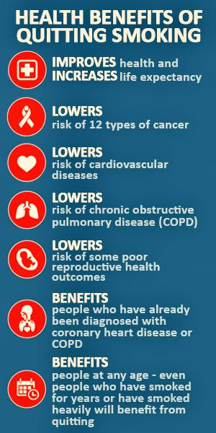
Benefits of not taking tobacco
☆ Good health.
☆ Prevent different types of Diseases.
☆ Family life will be better.
☆ Avoid dependency and live happy life.
☆ Longer survival.
☆ Lower risk of infection.
☆ Easier breathing.
☆ Better quality of life.

Slide 10
Steps to quit–tobacco
1. Drink lots of water and fluids
2. Stay away from alcohol, sugar and coffee and avoid fatty foods
3. After dinner, instead of a cigarette, treat yourself to a cup of mint tea or a peppermint candy
4. Go to a gym and jog around the block or park for to change your normal routine
5. Ask friends and family members not to smoke in your presence
6. On your quit day, hide all ashtrays and destroy all your cigarettes

Slide 11
Pledge
On this occasion of World No Tobacco Day, I take a pledge that I shall never smoke & consume any type of tobacco products in my life and motivate my family or acquaintances to not to smoke & use any tobacco products. I shall keep the campus of my office tobacco- free and shall also motivate my colleagues for the same.

Slide 12
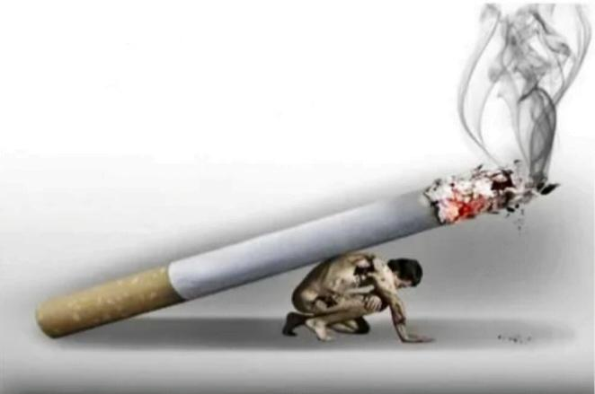
Quite smoking!
It weakens you, it ruins you.
THANK YOU
Made by :– Atul Anand
12th , Science
^{(NSS Volunteer)}

